Slide 2
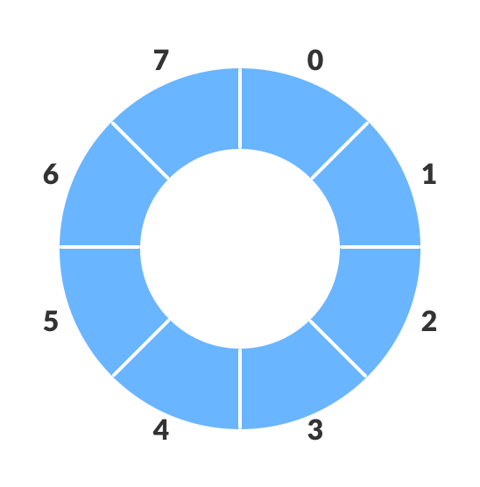
What is a Circular Queue?
A circular queue based on the FIFO (First In First Out) principle
The last position is connected to the first position
It is also known as a Ring Buffer.

Slide 3
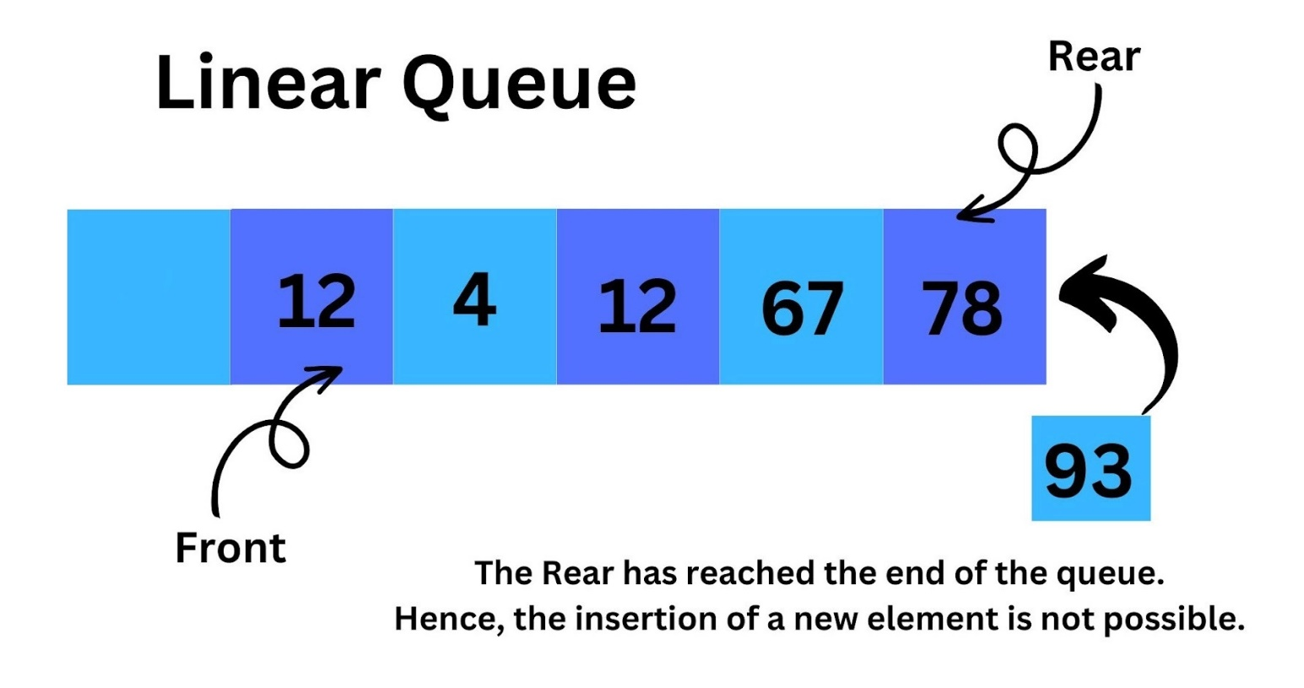
Why circular queue ?
If the rear reaches to the end position vacant spaces in the beginning cannot be utilized.

Slide 4
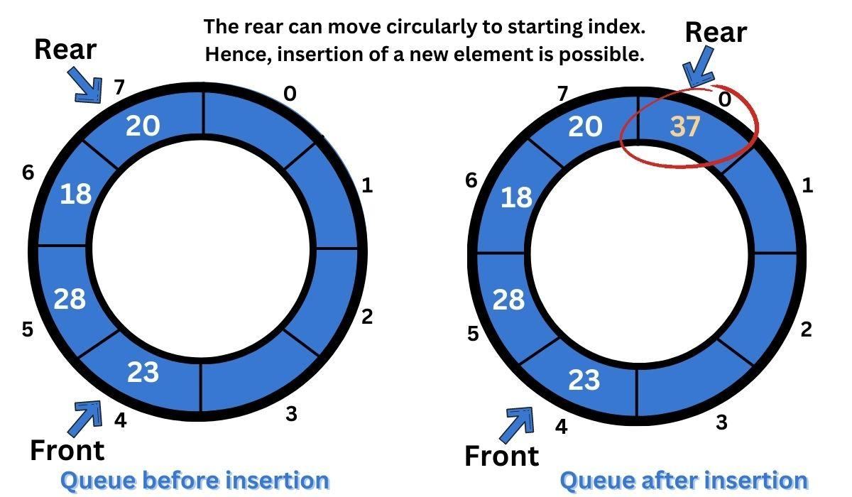
Operations on Circular Queue
enQueue(value):
Insert the new value in the Queue
from the rear end.
deQueue():
Deletes an element from the Queue
in the front end.

Slide 5
isFull & isEmpty
isFULL function:
if ((rear + 1) % N == front) {
cout << "Queue is full" <<endl;
isEmpty:
if (front == -1 && rear == -1) {
cout << "Queue is empty" ;

Slide 6
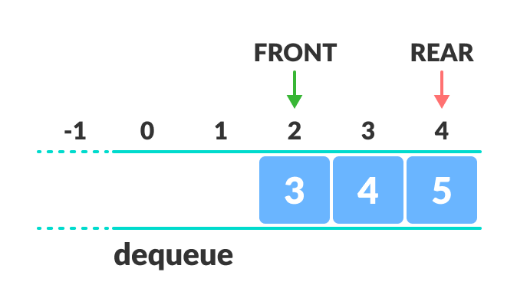
Why was circular queue introduced?
If the rear reaches to the end position vacant spaces in the beginning cannot be utilized.

Slide 7
Enqueue Function:
If isFull then return
If (front && rear == -1) then front = rear = 0
else rear = (rear + 1) % N
queue[rear] = x
N=5
Modulus gives remainder
0
1
2
3
4
10
11
12
13
14
15
Front
Rear

Slide 8
Dequeue Function:
If isEmpty then return
if (front == rear) then front = rear = -1
else front = (front + 1) % N
N=5
Modulus gives remainder
0
1
2
3
4
10
11
12
13
14
=
=
-1
Front
Rear

Slide 9
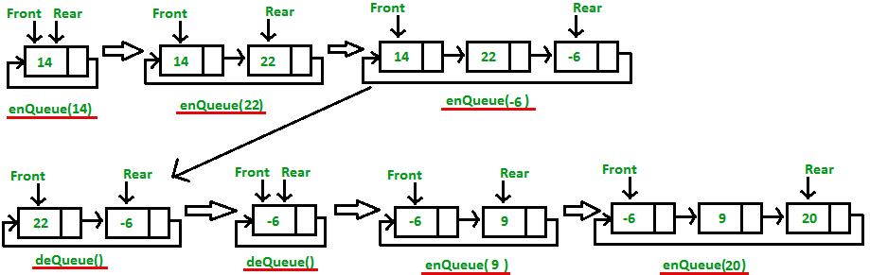
Circular queue using linked list

Slide 10
Eequeue Function using linkedlist:
void enqueue(int x) {
Node* newnode = new Node;
newnode->data = x;
newnode->next = NULL;
if (rear == NULL) {
front = rear = newnode;
rear->next = front;
} else {
rear->next = newnode;
rear = newnode;
rear->next = front;
}
}

Slide 11
Dequeue function using linkedlist:
void dequeue() {
Node* temp = front;
if (front == NULL && rear == NULL) {
cout << "\nQueue is empty";
} else if (front == rear) {
front = rear = NULL;
delete temp;
} else {
front = front->next;
rear->next = front;
delete temp;
}
}

Slide 12
Applications of Circular Queue
Memory management
CPU Scheduling
Traffic system

